Slide 1

DAYMARK ENERGY ADVISORS
MIS 584 – Business Intelligence Team 8 : Joseph, Stephen, Roshni & Supria

Slide 2
AGENDA
01
04
02
03
Proposed BI Solution
Project Prototypes
Introduction
Implications

Slide 3






Daymark Energy Advisors
SERVICES
Power System Planning
Clean Energy
Procurements and Portfolios
Regulatory Economics
Utility Rate Design
Small Consulting Firm
with 40 Employees
Workforce:
Executive Management
Energy Consultants
Energy Analysts

Slide 4



What does Daymark Energy Advisors do?
1
2
3
4
>
>
>
\
Consultant
Client/Supplier
Buyer/Supplier
End User
Consult on projects for companies who wish to be suppliers
Daymark’s clients who take up projects to site generators to supply energy
Buy from wholesale market. Sell to end users.
Houses, Industries, anyone who uses electricity

Slide 5




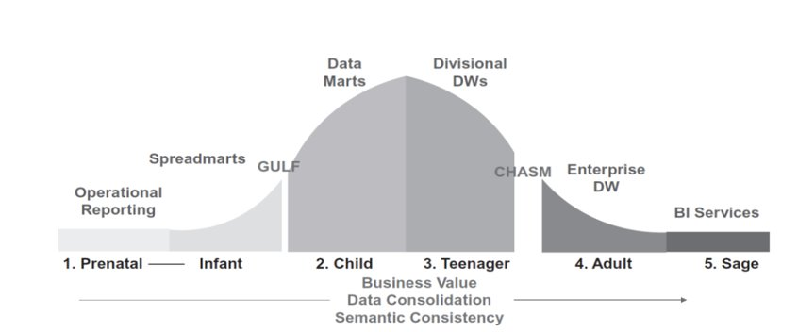
Daymark’s BI Model
Project Goal:
To create an easy, accessible, adoptable BI solution to help Daymark progress in the BI maturity model.
Problems Addressed:
- Created a comprehensive BI solution & visualization tool to efficiently access and analyze multiple data points.
- Provided recommendations to transform the organization.
Project Deliverables:
- Star Schema & Tech Stack
- Two Dashboards
- Forecasting model
- Implications and Recommendations
ANALYSIS
STORAGE
MANAGEMENT
NO BI TEAM

Slide 6



Case Studies
McKinsey and BCG are global management consulting firms that are part of the “Big Three”.
They incorporate innovative data driven tools to help their clients obtain solutions to their problems.

Slide 7
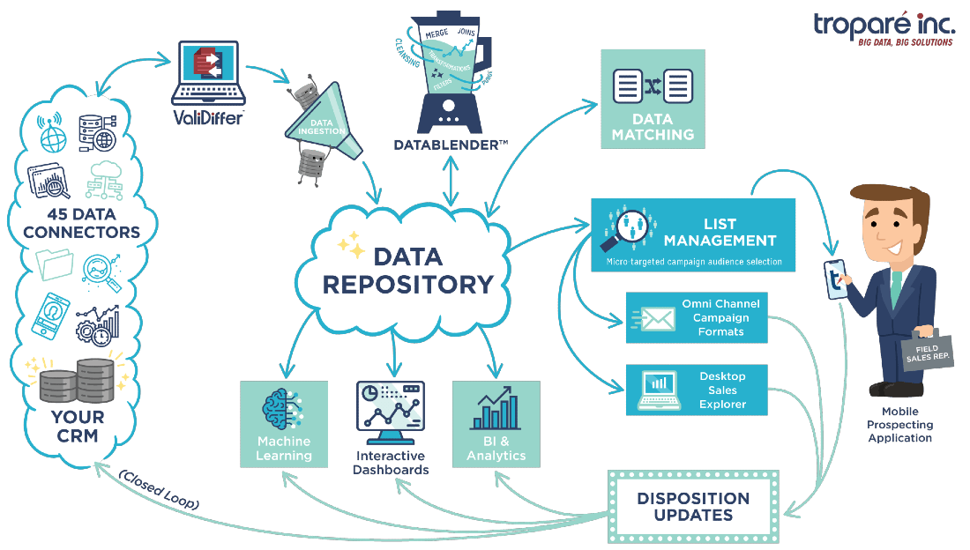
PROPOSED BI SOLUTION

Slide 8
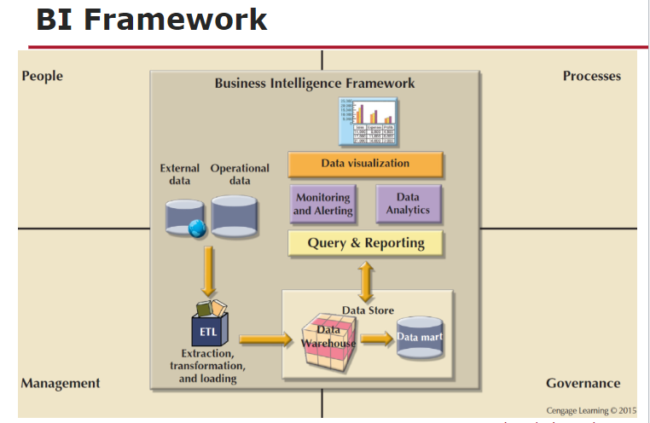
Proposed BI Solution

Slide 9




Proposed BI Solution BI Framework
1
2
3
4
PEOPLE
MANAGEMENT
GOVERNANCE
PROCESS
Front-line , power users and managers
Execs and managers, planning and KPI definitions
Access control, confidentiality, data quality & security , compliance
Visualization, Reporting , Analytics , Monitoring

Slide 10
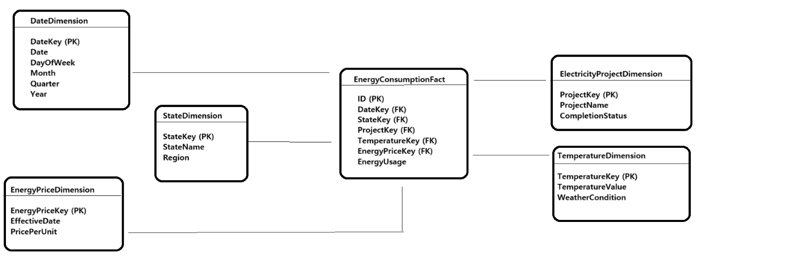
Proposed BI Solution STAR SCHEMA RDBMS

Slide 11





PROPOSED BI SOLUTION – TECH STACK
TECH
STACK
Cloud hosting
Visualization
- Tableau Online
- Amazon Web Services (AWS)
Extract, Transform, Load (ETL)
Relational Database
MySQL
- AWS Glue
Data Preparation and cleaning
Tableau Prep

Slide 12

PROJECT PROTOTYPES

Slide 13

Project Prototypes
1
Energy Load and Price Dashboard
Operational Dashboard
2
Project Queue Dashboard
Tactical Dashboard
3
Forecasting Model
Analytics

Slide 14







Energy Load and Price Dashboard
Data Source | Data Cleaning | Dashboard Type | Dashboard Users | Metrics/ KPIs | Dimensions | Interactive Filters
ISO New England website | 1. Categorization Zones to States Months to Weather | Operational Dashboard Data Refresh Daily | Primarily Analysts & Senior Analysts => Staff | 1. Day Ahead Load & Price 2. Real Time Load & Price 3. Temperature | 1. State 2. Weather | 1. State 2. Weather 3. Date Parameter (Summary tiles only)

Slide 15
Project Queue Dashboard
Data Source | Data Cleaning | Dashboard Type | Dashboard Users | Metrics/ KPIs | Dimensions | Interactive Filters
ISO New England website | 1. Categorization Fuel Type to Fuel 2. Imputation Project status blank to “Not Started” 3. Removed Null & N/A | Tactical Dashboard Data Refresh Daily | Primarily Consultants & Senior Consultants => Project Managers | 1. Energy Capacity 2. Project Count | 1. Operation Date 2. Project Status 3. Withdrawn projects 4. Fuel Category 5. State 6. Project Type | 1. Year of Op Date 2. Project Type 3. State 4. Fuel Category

Slide 16
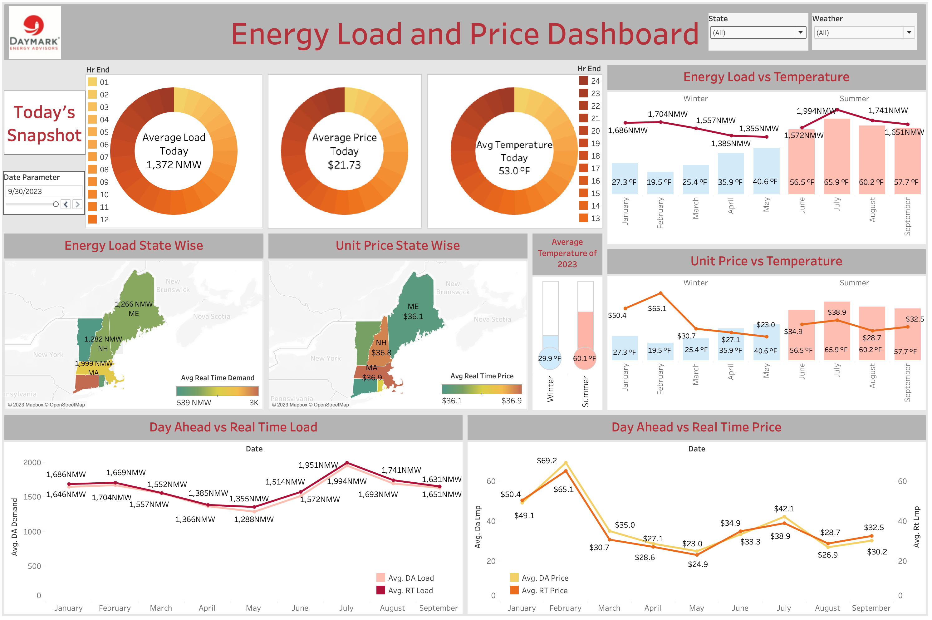
Energy Load and Price Dashboard
Managerial Questions
1
1
What is the correlation between temperature and load, temperature and price?
3
1
2
How far is the real time (actual) load and price from the day head prediction?
2
2
How does the load and price vary in New England States? Which is the most feasible state to place generator in? Which state is most feasible to start an industry?
3

Slide 17
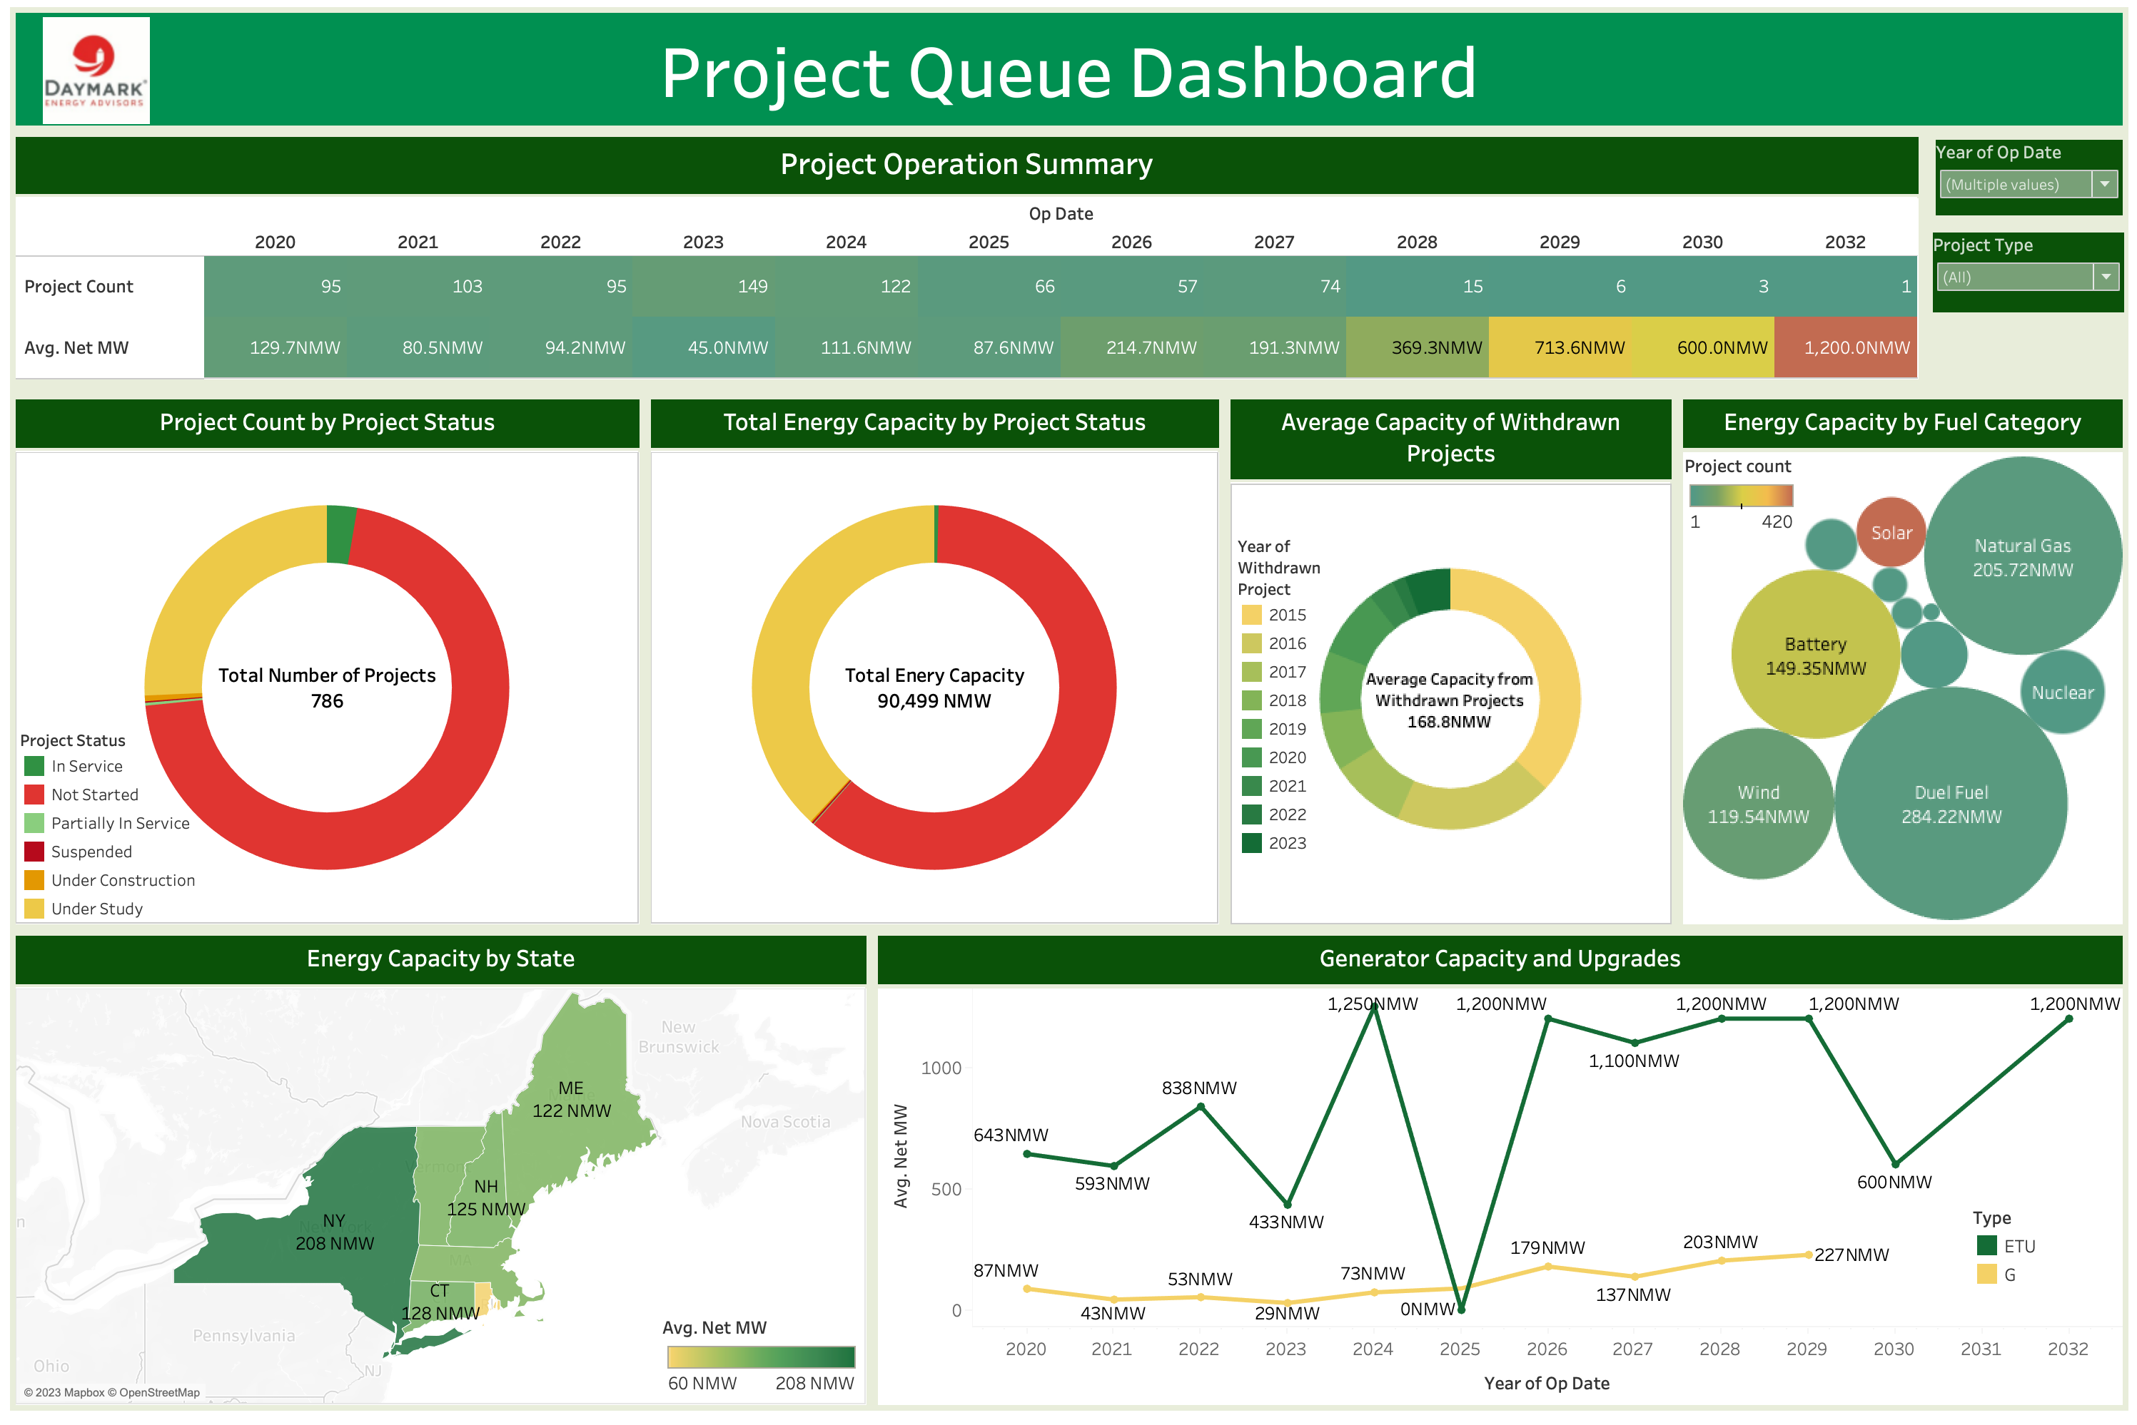
Project Queue Dashboard
3
Managerial Questions
Which is the most feasible fuel category to set up a generator in and in which state?
1
1
2
For Project A, I wish to make transmission upgrades in the next 3 years. Which is the best year to upgrade?
2
Which year is generating the highest and lowest energy? Which year would be most feasible to operate a generator from?
1
3

Slide 18
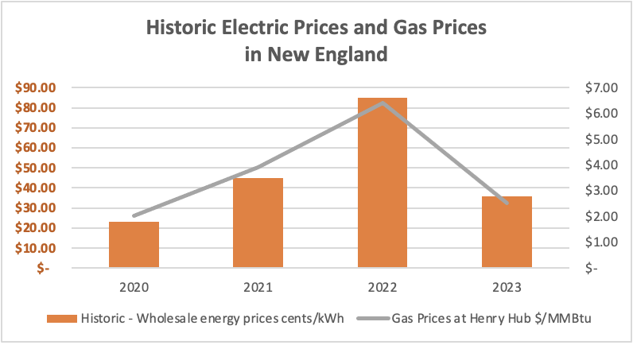
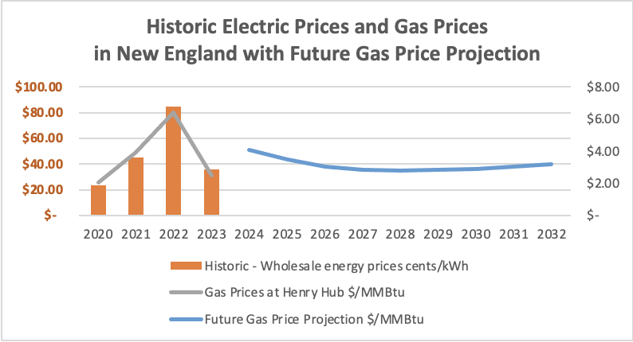
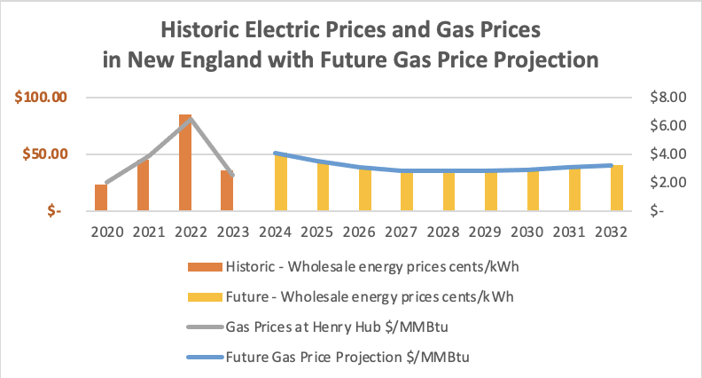
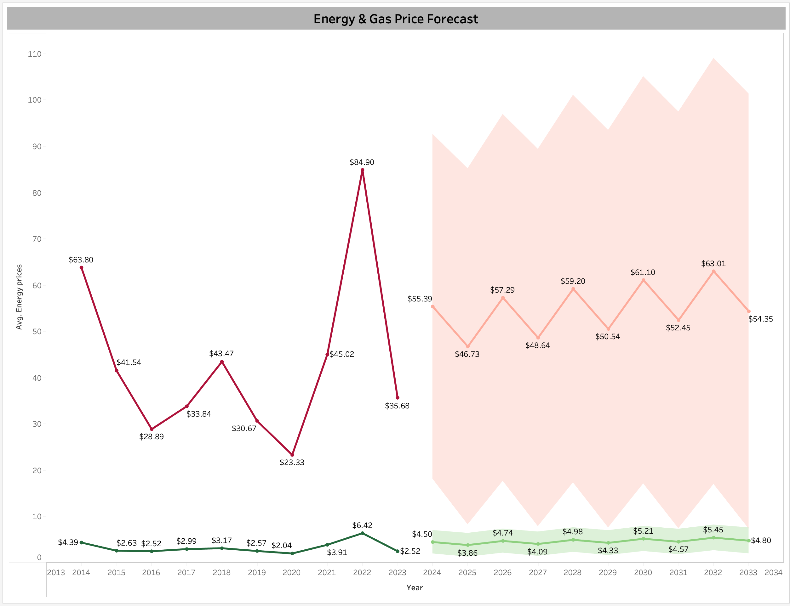
Analytics – Forecasting Model
2
2
3
4
1
Energy Price Forecasting – Excel
2
Energy & Gas Price highly correlated. Future Gas prices available
3
Hence, energy price forecasted using gas prices
4
Forecasted both energy and gas prices till 2033 using data from 2014 - Tableau
5
Data Source – U.S Energy Information Administration website

Slide 19


BI Implementation Process for Daymark

Slide 20
Managerial Implications - Kotter's Eight-Step Model
Create Urgency
Remove Obstacles
1
Move the data management system from excel to the next BI stage level to manage scattered data into a structured way emphasizing the importance of BI in today's competitive landscape
5
Upgrade technology infrastructure
Address employee resistance
Create Short-time wins
6
2
Form a Powerful Coalition
Creating dashboards and
forecasting models
Assemble a cross-functional team
Collaborate with external BI experts
Build on the Change
7
3
Create a Vision for Change
Scale up BI implementation gradually
Hire BI experts
A 5-year goal to be a data efficient consulting firm
Anchor the Changes in
Corporate Culture
8
4
Communicate the Vision
Conduct workshops, training sessions, and meetings
Recognize and reward employees contributing to BI initiatives

Slide 21
Technical Implications - Addressing Data Quality Issues
1
Data Profiling and Cleaning
Utilize Tableau Prep
Identify inconsistencies, errors, and missing values in datasets from ISO New England and U.S Energy Information Administration
1
2
Data Validation and Verification
3
Implement robust data validation processes to ensure accuracy
Regularly verify data integrity using AWS Glue for efficient Extract, Transform, Load (ETL) operations
2
3
Quality Assurance Protocols
Establish QA protocols for data entering MySQL databases
Conduct regular audits to identify and rectify discrepancies

Slide 22
Privacy Concerns - Ethical Implications & Mitigation
1
5
Data Governance Policies
Threats from Within
Prevent internal data leaks and address risks
For client data access (Massachusetts Data Privacy Law – 201 CMR 17.00 )
2
6
Data Security
Anonymization and Aggregation
To mitigate weak encryption or third-party attack risks(GDPR, CPPA)
To protect individual identities
7
3
Data Retention and Destruction Policies
Ethical Training
On privacy and legal compliance
4
8
Define clear policies to reduce data risks
Continuous Monitoring
Privilege Control & Encryption
Audit data access regularly to identify breaches
Secure data with encryption and access controls

Slide 23
Closing Thoughts
Successful BI implementation using proposed strategies will elevate Daymark's efficiency and maturity
20%
Recommendations align with industry best practices
30%
Continuous improvement, regular updates and adaptation are crucial for long-term success

Slide 24

References
https://www.mckinsey.com/careers/search-jobs/jobs/principaldataengineer-quantumblack-74655
https://en.wikipedia.org/wiki/ISO_New_England
https://www.bcg.com/capabilities/digital-technology-data/digital-platform
https://en.wikipedia.org/wiki/Energy_Information_Administration
https://help.tableau.com/current/pro/desktop/en-us/forecast_how_it_works.htm
https://aws.amazon.com/glue/

Slide 25
THANK YOU
MIS 584 – Business Intelligence Team 8 : Joseph, Stephen, Roshni & Supria

